Slide 1

15CSE301 Computer Organization and Architecture
Lab 1
Introduction to iverilog
Dr Ganesh Neelakanta Iyer
Associate Professor, Dept of Computer Science and Engg
Amrita Vishwa Vidyapeetham, Coimbatore

Slide 2
15CSE381 – COA Lab
Icarus Verilog is a free compiler implementation for the IEEE-1364 Verilog hardware description language
http://bleyer.org/icarus/
We will use this to simulate hardware design in our lab
/* A simple and gate
File: 1_and.v */
module andgate (a, b, y);
input a, b;
output y;
// using data flow abstraction
assign y = a & b;
//using gate level abstraction
//and a1(y,a,b);
//run either gate level or data flow level code
endmodule

Slide 3
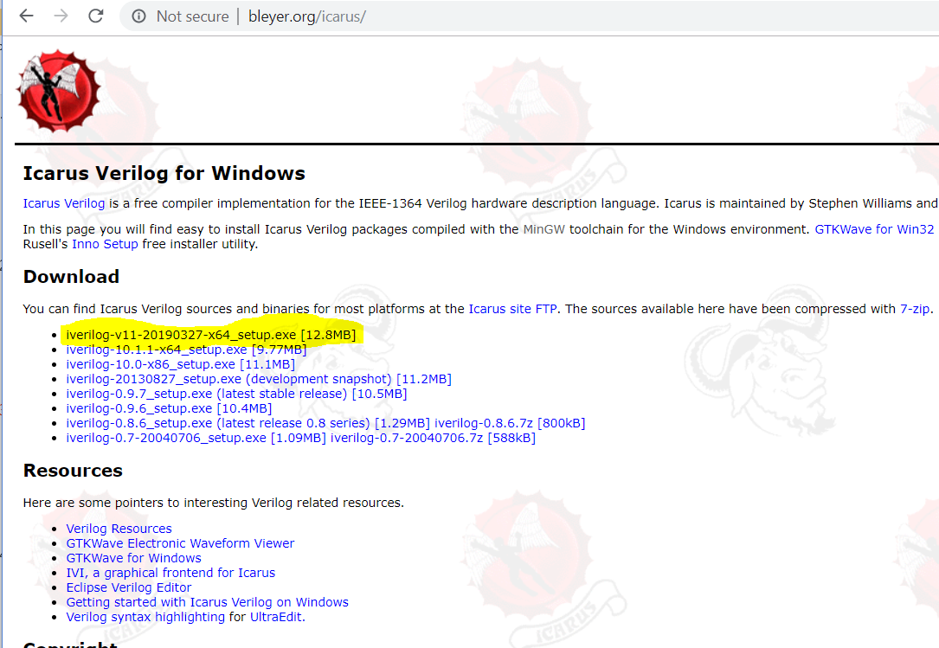
iverilog

Slide 4
Procedure
Complete the installation
Open the folder mentioned during the installation
In my case, it was C:\iverilog
You can write your first hello.v program in the bin folder under C:\iverilog

Slide 5
hello.v
module hello;
initial
begin
$display("Hello, World");
$finish ;
end
endmodule

Slide 6
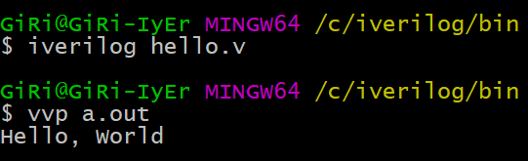
Running Verilog code
Open command prompt under C:\iverilog\bin
compile this program with the command:
iverilog -o hello hello.v
The results of this compile are placed into the file "hello", because the "-o" flag tells the compiler where to place the compiled result. Next, execute the compiled program like so:
vvp hello
Hello, World

Slide 7
Resources
http://vol.verilog.com/VOL/main.htm
http://www.referencedesigner.com/tutorials/verilog/verilog_01.php
http://electrosofts.com/verilog/introduction.html

Slide 8
Office Hours
Monday 1120-1210 @ My office

